Slide 1
Data Mining and Data Warehousing
Unit 1
Introduction to Data warehousing

Slide 2
Data Warehouse
A data warehouse is constructed by integrating data from multiple heterogeneous sources that support analytical reporting, structured queries, and decision making
Data warehousing is the process of constructing and using a data warehouse
Nature of Data Warehouse
Subject Oriented
Integrated
Non Volatile
Time variant

Slide 3
Data Warehouse—Subject-Oriented
Organized around major subjects, such as customer, product, sales
Focusing on the modeling and analysis of data for decision makers, not on daily operations or transaction processing
Provide a simple and concise view around particular subject

Slide 4
Data Warehouse—Integrated
Constructed by integrating multiple, heterogeneous data sources
relational databases, flat files, on-line transaction records
Data cleaning and data integration techniques are applied.
Ensure consistency in naming conventions, encoding structures, attribute measures, etc. among different data sources
E.g., Hotel price: currency, tax, breakfast covered, etc.
When data is moved to the warehouse, it is converted.

Slide 5
Data Warehouse—Time Variant
The time horizon for the data warehouse is significantly longer than that of operational systems
Operational database: current value data
Data warehouse data: provide information from a historical perspective (e.g., past 5-10 years)
Every key structure in the data warehouse
Contains an element of time, explicitly or implicitly

Slide 6
Data Warehouse—Nonvolatile
A physically separate store of data transformed from the operational environment
Operational update of data does not occur in the data warehouse environment
Does not require transaction processing, recovery, and concurrency control mechanisms
Requires only two operations in data accessing:
Initial loading of data and Access of data

Slide 7
Types of Data
Database-oriented data sets and applications
Relational database, data warehouse, transactional database
Advanced data sets and advanced applications
Data streams and sensor data
Time-series data
Structure data, graphs, social networks and multi-linked data
Heterogeneous databases and legacy databases
Spatial data and spatiotemporal data
Multimedia database
Text databases
The World-Wide Web

Slide 8
Types of Database
Relational database
Data warehouse
Transactional database

Slide 9
Data Warehouse Architecture
Four views regarding the design of a data warehouse
Top-down view
allows selection of the relevant information necessary for the data warehouse
Data source view
exposes the information being captured, stored, and managed by operational systems
Data warehouse view
consists of fact tables and dimension tables
Business query view
sees the perspectives of data in the warehouse from the view of end-user

Slide 10
Data Warehouse Architecture…………
Monitor
&
Integrator
OLAP Server
Other
sources
Metadata
Analysis
Query
Reports
Data mining
Operational
DBs
Extract
Transform
Load
Refresh
Data
Warehouse
Serve
Data Marts
Data Sources
Data Storage
OLAP Engine
Front-End Tools

Slide 11
Components of Data Warehouse
Load Manager
Responsible for loading the extracted clean data into data warehouse
Query Manager
Responsible for handling the user query
Scheduling the query
Directing the query to the relevant data cube
Warehouse Manager
Responsible for maintaining the integrity and consistency of data warehouse
Disaster management
Regular back up

Slide 12
Database Vs Data Warehouse
Data warehouse technology includes a set of concepts and methods that offer the users useful information for decision making
The necessity to build a data warehouse arises from the necessity to improve the quality of information in the organization
A database is an application-oriented collection of data
A data warehouse is a subject-oriented collection of data

Slide 13
OLTP
OLTP (On-line Transaction Processing) is characterized by a large number of short on-line transactions (INSERT, UPDATE, DELETE)
The main emphasis for OLTP systems is put on very fast query processing, maintaining data integrity in multi-access environments and an effectiveness measured by number of transactions per second
In OLTP database there is detailed and current data, and schema used to store transactional databases

Slide 14
OLAP
OLAP (On-line Analytical Processing) is characterized by relatively low volume of transactions
Queries are often very complex and involve aggregations
For OLAP systems a response time is an effectiveness measure
OLAP applications are widely used by Data Mining techniques
In OLAP database there is aggregated, historical data, stored in multi-dimensional schemas

Slide 15
OLTP vs. OLAP

Slide 16
Multidimensional Data Model
The multidimensional data model is an integral part of On-Line Analytical Processing, or OLAP.
Because OLAP is on-line, it must provide answers quickly; analysts pose iterative queries during interactive sessions, not in batch jobs that run overnight.
And because OLAP is also analytic, the queries are complex
The multidimensional data model is designed to solve complex queries in real time.
Logical view of the enterprise

Slide 17
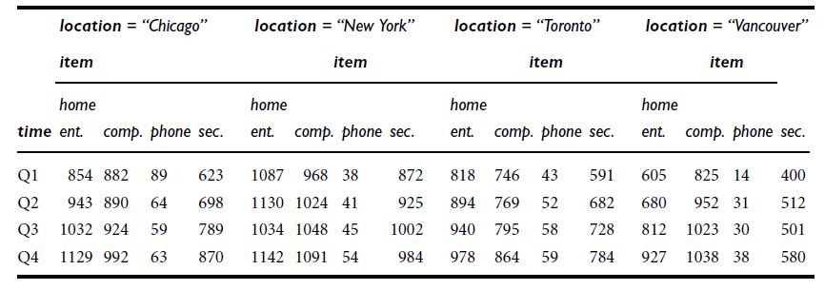
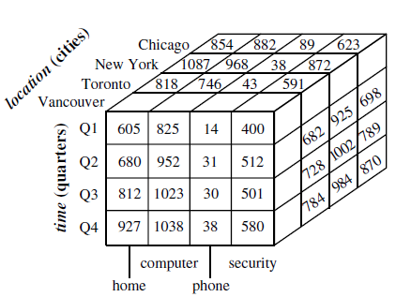
Multidimensional Data Model

Slide 18
Conceptual Modeling of Data Warehouses
Modeling data warehouses: dimensions & measures
Star schema: A fact table in the middle connected to a set of dimension tables
Snowflake schema: A refinement of star schema where some dimensional hierarchy is normalized into a set of smaller dimension tables, forming a shape similar to snowflake
Fact constellations: Multiple fact tables share dimension tables, viewed as a collection of stars, therefore called galaxy schema or fact constellation

Slide 19
Example of Star Schema
time
time_key
day
day_of_the_week
month
quarter
year
item
item_key
item_name
brand
type
supplier_type
Sales Fact Table
time_key
item_key
branch_key
branch
location
location_key
branch_key
branch_name
branch_type
location_key
street
city
state_or_province
country
units_sold
dollars_sold
avg_sales
Measures

Slide 20
Example of Snowflake Schema
time
item
time_key
day
day_of_the_week
month
quarter
year
item_key
item_name
brand
type
supplier_key
supplier
Sales Fact Table
supplier_key
supplier_type
time_key
item_key
branch_key
branch
location
location_key
location_key
street
city_key
branch_key
branch_name
branch_type
units_sold
dollars_sold
city
city_key
city
state_or_province
country
avg_sales
Measures

Slide 21
Example of Fact Constellation
time
time_key
day
day_of_the_week
month
quarter
year
item
Shipping Fact Table
item_key
item_name
brand
type
supplier_type
Sales Fact Table
time_key
time_key
item_key
shipper_key
item_key
branch_key
from_location
branch
location_key
location
to_location
branch_key
branch_name
branch_type
units_sold
location_key
street
city
province_or_state
country
dollars_cost
dollars_sold
units_shipped
avg_sales
shipper
Measures
shipper_key
shipper_name
location_key
shipper_type

Slide 22
OLAP Operations
OLAP provides a user-friendly environment for interactive data analysis.
A number of OLAP data cube operations exist to materialize different views of data, allowing interactive querying and analysis of the data
Operations
Roll Up (Drill Up)
Roll Down (Drill Down)
Slice
Dice
Pivot (allows an analyst to rotate the cube in space to see its various faces. For example, cities could be arranged vertically and products horizontally while viewing data for a particular quarter.)

Slide 23
OLAP Operations…
Roll Down (Drill Down)
From higher level summary to lower level summary or detailed data, or introducing new dimensions
Roll Up (Drill Up)
A roll-up involves summarizing the data along a dimension
Takes the current aggregation level of fact values and does a further aggregation on one or more of the dimensions

Slide 24
OLAP Operations…

Slide 25
Slice and Dice
Slice: a selection on one dimension of the cube resulting in subcube
Ex: sales data are selected for dimension time using time =spring
dice: defines a subcube by performing a selection on two or more dimensions
Ex: a dice opp. Based on
location=“london” or “glasgow” and
time =spring or summer and
item = “T-shirts” or “Pyjamas”

Slide 26
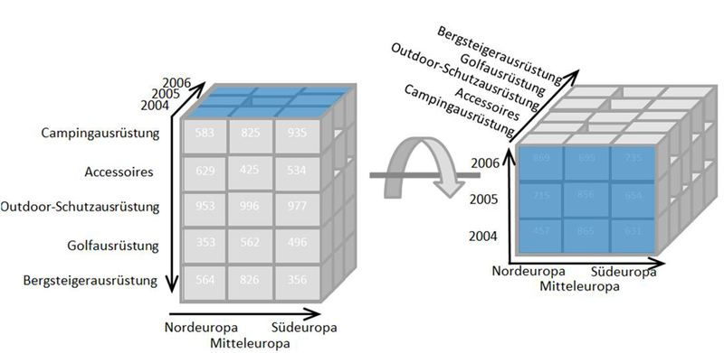
Pivoting

Slide 27
OLAP Server Architectures
Relational OLAP (ROLAP)
Use relational or extended-relational DBMS to store and manage warehouse data and OLAP middle ware
Include optimization of DBMS backend, implementation of aggregation navigation logic, and additional tools and services
Greater scalability
Multidimensional OLAP (MOLAP)
Sparse array-based multidimensional storage engine
Fast indexing to pre-computed summarized data
Hybrid OLAP (HOLAP) (e.g., Microsoft SQLServer)
Flexibility, e.g., low level: relational, high-level: array

Slide 28
ROLAP
Relational OLAP (ROLAP) servers: These are the intermediate servers that stand in between a relational back-end server and client front-end tools. They use a relational or extended-relational DBMS to store and manage warehouse data, and OLAP middleware to support missing pieces. ROLAP servers include optimization for each DBMS back end, implementation of aggregation navigation logic, and additional tools and services. ROLAP technology tends to have greater scalability than MOLAP technology.

Slide 29
MOLAP
These servers support multidimensional views of data through array-based multidimensional storage engines. They map multidimensional views directly to data cube array structures. The advantage of using a data cube is that it allows fast indexing to pre computed summarized data. Notice that with multidimensional data stores, the storage utilization may be low if the data set is sparse. In such cases, sparse matrix compression techniques should be explored (Chapter 4).
Many MOLAP servers adopt a two-level storage representation to handle dense and sparse data sets: denser subcubes are identified and stored as array structures, while sparse subcubes employ compression technology for efficient storage utilization

Slide 30
HOLAP
The hybrid OLAP approach combines ROLAP and MOLAP technology, benefiting from the greater scalability of ROLAP and the faster computation of MOLAP.
For example, a HOLAP server may allow large volumes of detail data to be stored in a relational database, while aggregations are kept in a separate MOLAP store. The Microsoft SQL Server 2000 supports a hybrid OLAP server

Slide 31
Assignment
Life cycle of data
Data marts
Data warehouse implementation
Need for data warehousing
Trends of data warehousing

Slide 32
End of Session

